Slide 1
Activity Diagrams
Lecture

Slide 2
Activity Diagrams
It is a behavioral diagram that illustrates the flow of activities through a system.
Activity diagram is basically a flowchart to represent the flow from one activity to another activity.
The activity can be described as an operation (function) of the system.
The control flow is drawn from one operation to another. This flow can be sequential, branched, or concurrent.
Activity diagrams deal with all type of flow control by using different elements such as fork, join, etc

Slide 3
Activity Diagrams: When to use?
The main reason to use activity diagrams is to model the workflow behind the system being designed.
Activity Diagrams are also useful for: analyzing a use case by describing what actions need to take place and when they should occur.
Activity diagrams do not give detail about how objects behave or how objects collaborate.

Slide 4
Activity diagrams - Notations
Activity
Activity states - Represent the individual steps or actions in a process.
Transition - Show the flow from one activity to the next.
Decisions (branch) for which a set of guard conditions are defined. These are conditions that must be met to trigger the transition.
Synchronization bars - which you can use to show parallel sub-flows. Synchronization bars allow you to show concurrent threads - fork node or join node.

Slide 5
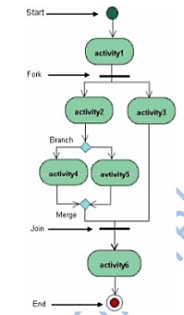
How to Draw Activity Diagrams
Activities (oval): Represent the individual steps or actions in a process.
Transitions (arrows): Show the flow from one activity to the next.
Initial Node (filled circle): Indicates the starting point of the diagram.
Final Node (bull’s eye): Represents the end of the process.
Decision Nodes (diamond): Represent points where a decision is made, leading to different paths.
Merge Nodes (diamond): Combine multiple paths into one.
Fork Nodes (vertical line): Split one flow into multiple concurrent flows.
Join Nodes (vertical line): Combine multiple concurrent flows into one.

Slide 6
Rules
Activity diagrams show the flow of activities through the system.
Diagrams are read from top to bottom and have branches and forks to describe conditions and parallel activities.
A fork is used when multiple activities are occurring at the same time.
The branch describes what activities will take place based on a set of conditions (decisions).
All branches at some point are followed by a merge to indicate the end of the conditional behavior started by that branch.
After the merge all of the parallel activities must be combined by a join before transitioning into the final activity state.

Slide 7
Activity Diagram: An Example
Draw activity diagram with the four main activities:
Send order by the customer
Receipt of the order
Confirm order
Dispatch order
After receiving the order request condition checks are performed to check if it is normal or special order.
After the type of order is identified dispatch activity is performed and that is marked as the termination of the process.

Slide 8
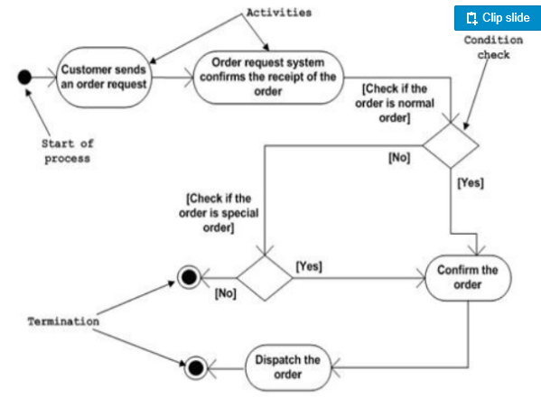
Note:
There should be only one start and one end of an activity diagram.
There should always a merge after each decision.

Slide 9
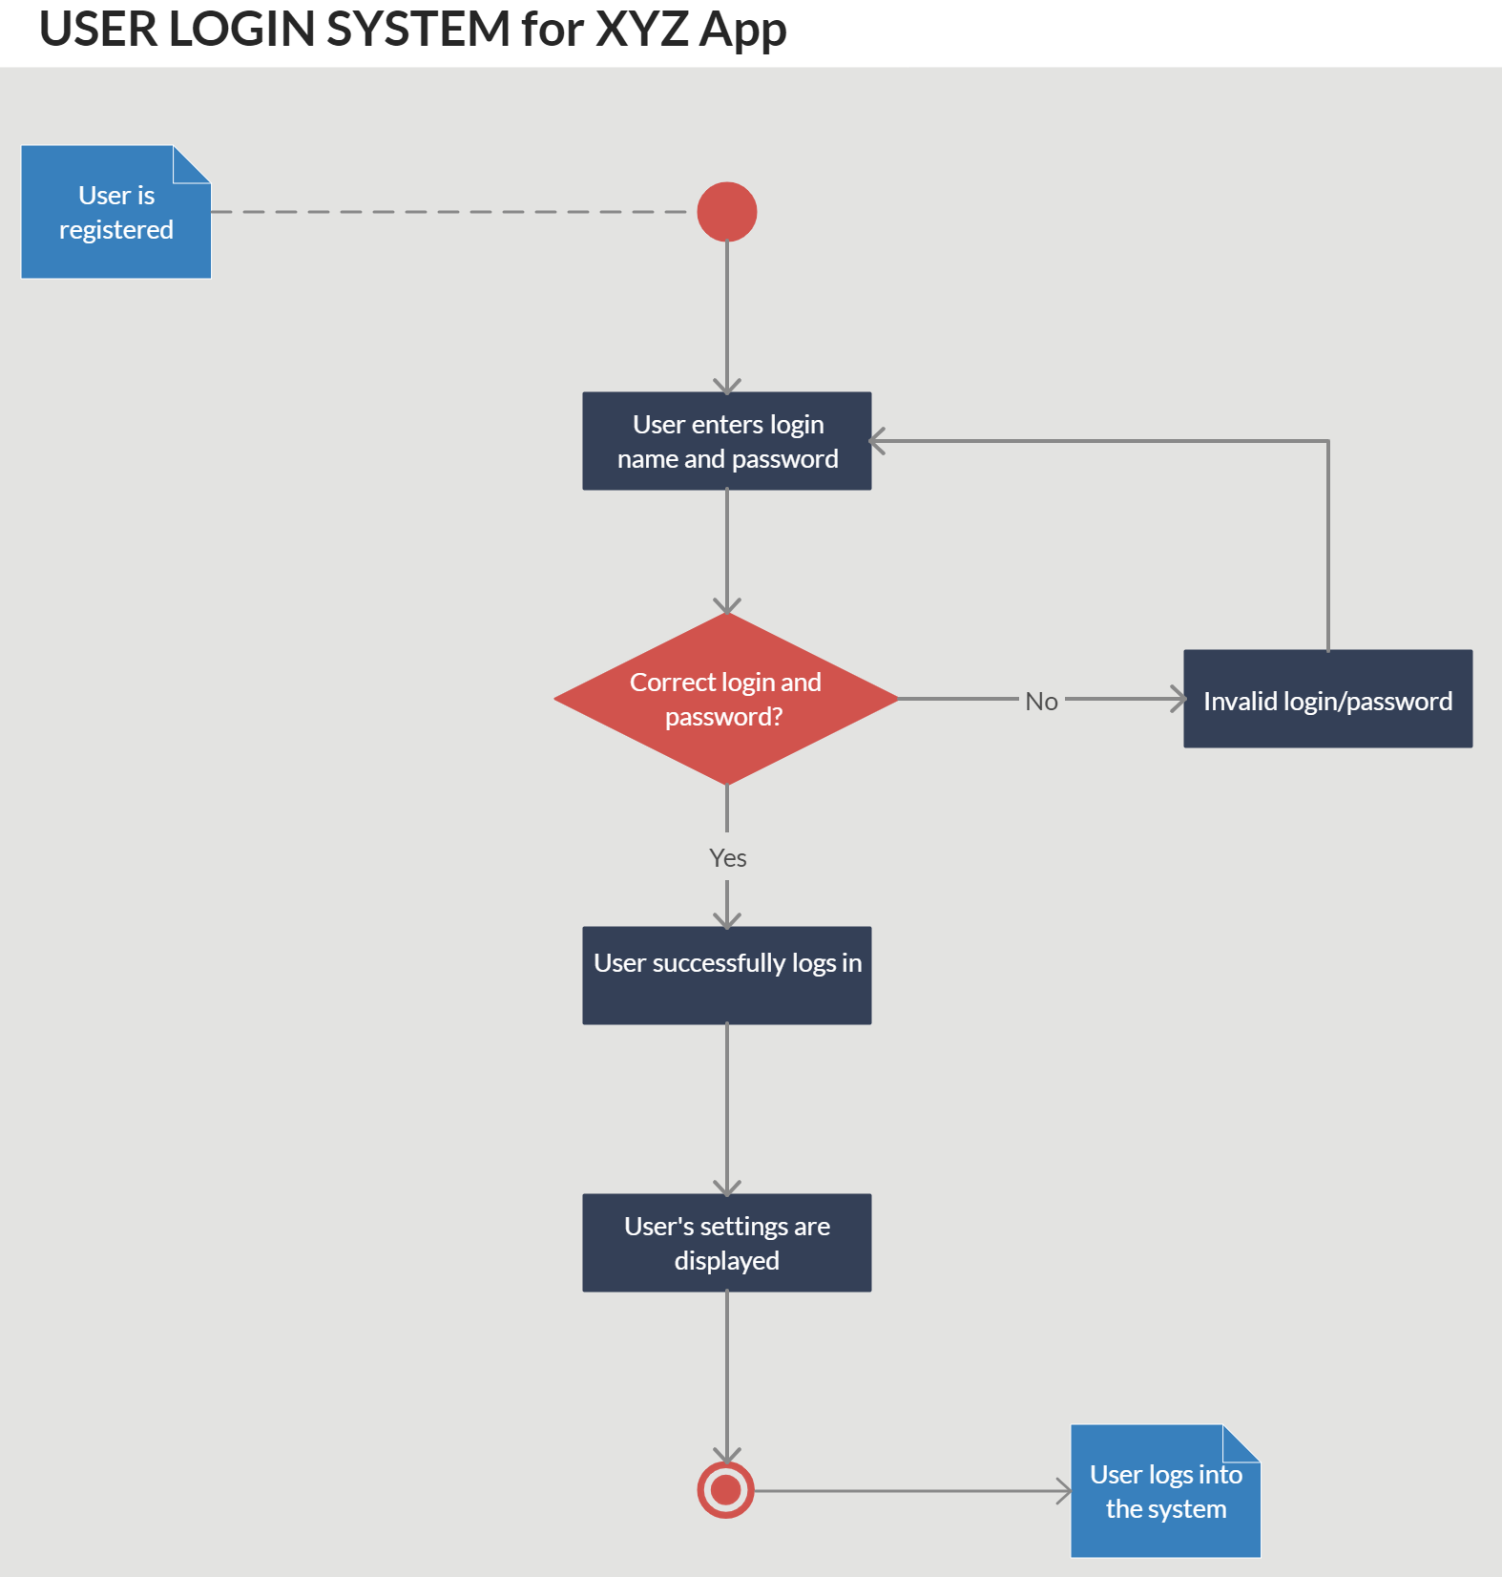

Slide 10
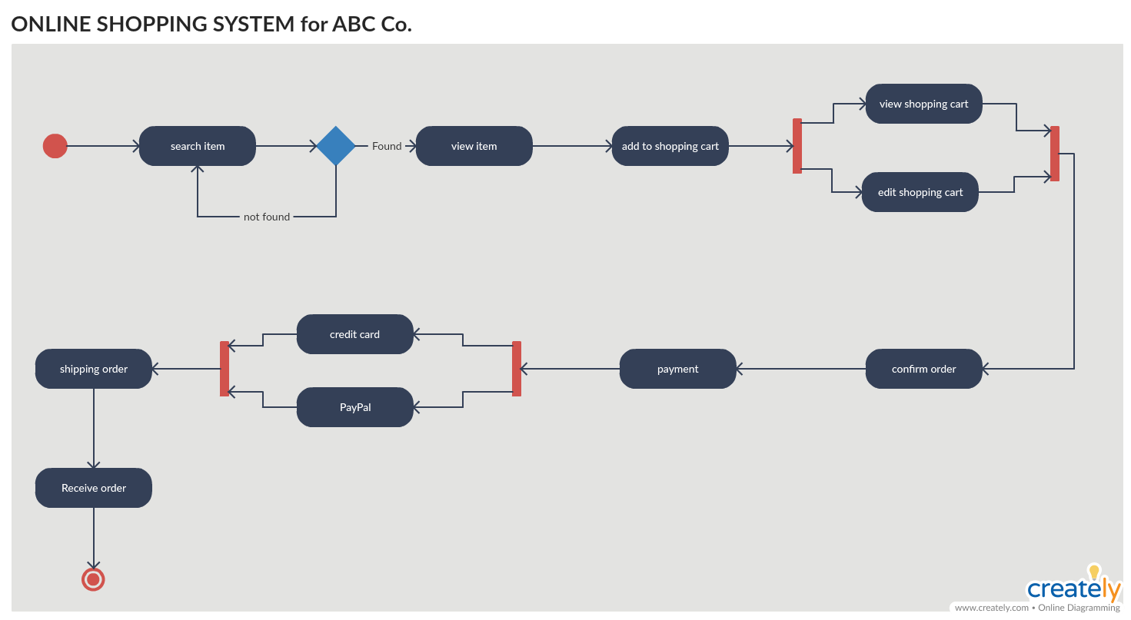

Slide 11
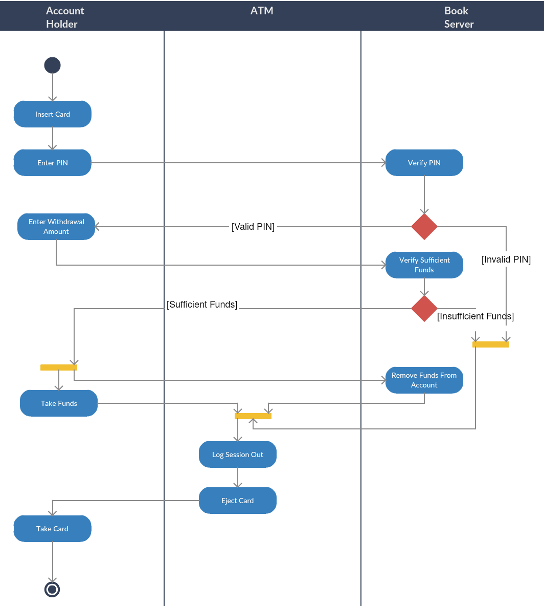
User
Bank
ATM Activity Diagram (Swimlane)
Swimlane Activity Diagrams are an extension of traditional activity diagrams that add structure by dividing activities into lanes. Each lane represents a different actor, department, or system, allowing for clearer visualization of responsibilities and interactions.
Key Components of Swimlane Activity Diagrams:
Swimlanes: Vertical or horizontal sections that divide the diagram based on different actors or entities.

Slide 12
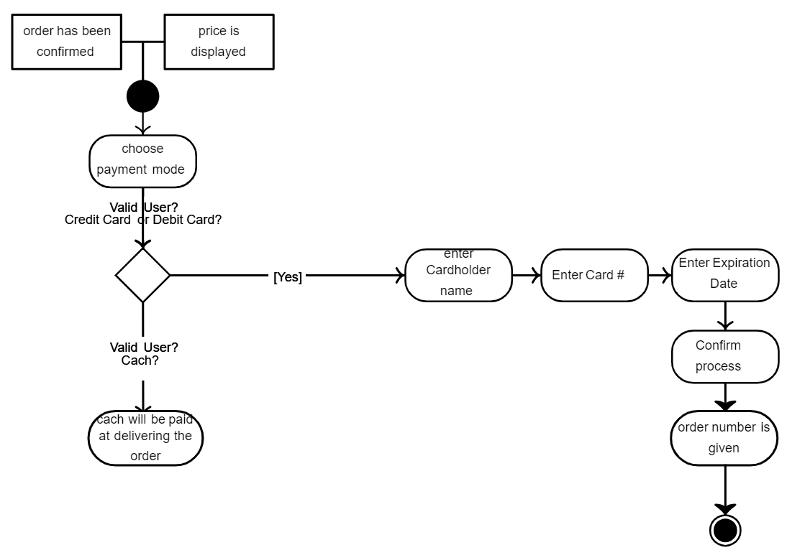
Make Payment activity diagram

Slide 13
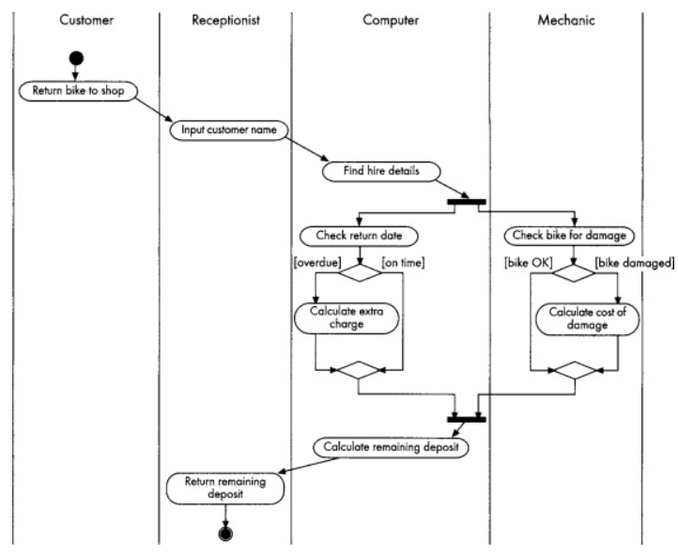
Activity Diagram for the ‘Handle bike return’ use case

Slide 14
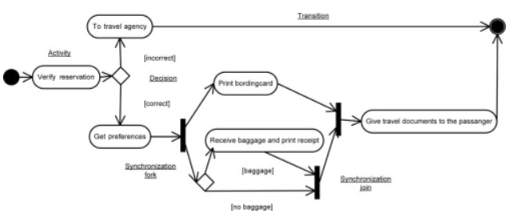
Activity Diagram for the ‘Check-in at the airport’

Slide 15
How to Draw Activity diagrams
Step 1: Figure out the action steps from the use case
Here you need to identify the various activities and actions your business process or and actions your business process or system is made up of is made up of.
Step 2: Identify the actors who are involved
If you already have figured out who the actors are, then it’s easier figured out who the actors are, then it’s easier to discern each action they are responsible for discern each action they are responsible for.
Step 3: Find a flow among the activities
Figure out in which order the actions are processed. Mark down the conditions that have to be met in order to carry out certain processes, which actions occur processed. Mark down the conditions that have to be met in order to carry out certain processes, which actions occur at the same time and whether you need to add any branches in the diagram and whether you need to add any branches in the diagram.
Step 4: Add swim lanes
You have already figured out who is responsible for each action You have already figured out who is responsible for each action. Now it’s time to assign them Now it’s time to assign them a swim lane and group each action they are responsible for under them swim lane and group each action they are responsible for under them.

Slide 16
Sequence Diagrams (Interaction Diagram)
Lecture

Slide 17
Sequence Diagrams (Interaction Diagram)
Sequence diagrams, commonly used by developers, model the interactions between objects in a single use case.
In simpler words, a sequence diagram shows different parts of a system work in a ‘sequence’ to get something done.
Sequence diagrams describe interactions among objects in terms of an exchange of messages over time.
Sequence diagrams show a detailed flow for a specific use case or even just part of a specific use case.
The focus is on the order in which messages occur.
Notes:
Refrence: https://youtu.be/IFqhoJJ3q8A

Slide 18
Elements of Sequence diagrams
Life lines
Messages
Objects
Send
Receive

Slide 19
Elements of Sequence diagrams
Actors: Represent the external entities that interact with the system. They are usually depicted as stick figures.
Objects (Participants): Represent the instances of classes that interact during the sequence. They are shown as rectangles with their names inside. Take them as names of the variables.
Lifelines: Represent the object's presence over time, depicted as dashed lines descending from the object rectangle.
Messages: Directed arrows that represent the communication between objects. They indicate the direction and type of interaction.
Activation Bars (Execution Occurrence): Thin rectangles on a lifeline that show when an object is active or controlling the flow.
Destroy Message: A message that indicates an object's destruction.
Combined Fragments: Used to represent control structures like loops, alternatives (if-else conditions), and parallel execution.

Slide 20
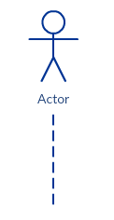
Life Line
A sequence diagram is made up of several of these lifeline notations that should be arranged horizontally across the top of the diagram.
No two lifeline notations should overlap each other.
They represent the different objects or parts that interact with each other in the system during the sequence.
A lifeline notation with an actor element symbol is used when the particular sequence diagram is owned by a use case.
Object

Slide 21
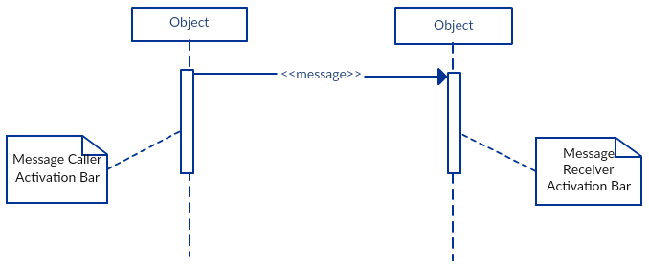
Activation Bars
The length of the rectangle indicates the duration of the objects staying active.
In a sequence diagram, an interaction between two objects occurs when one object sends a message to another.
The use of the activation bar on the lifelines of the Message Caller (the object that sends the message) and the Message Receiver (the object that receives the message) indicates that both are active/is instantiated during the exchange of the message.
Activation bar is the box placed on the lifeline.
It is used to indicate that an object is active (or instantiated) during an interaction between two objects.

Slide 22
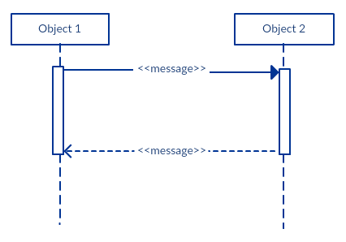
Message Arrows
While you can describe the message being sent from one object to the other on the arrow, with different arrowheads you can indicate the type of message being sent or received.
Return Messages
A return message is used to indicate that the message receiver is done processing the message and is returning control over to the message caller.
Return messages are optional notation pieces, for an activation bar that is triggered by a synchronous message always implies a return message.
An arrow from the Message Caller to the Message Receiver specifies a message in a sequence diagram.
A message can flow in any direction; from left to right, right to left or back to the Message Caller itself.
The message arrow comes with a description, which is known as a message signature, on it.
The format for this message signature is below.
message_name (arguments):returntype
All parts are optional except the message_name .
Tip: You can avoid cluttering up your diagrams by minimizing the use of return messages

Slide 23
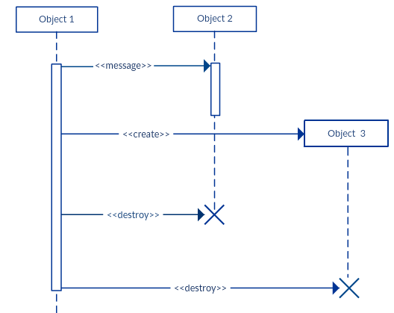
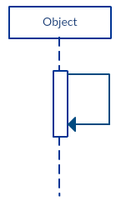
Destruction Message
Reflexive Message
When an object sends a message to itself, it is called a reflexive message.
It is indicated with a message arrow that starts and ends at the same lifeline as shown in the example below.
Participants when no longer needed can also be deleted from a sequence diagram.
This is done by adding an ‘X’ at the end of the lifeline of the said participant.

Slide 24
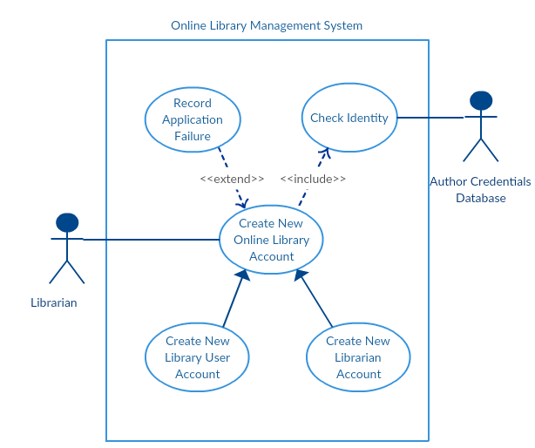
How to draw Sequence Diagram
Focus on the use case named ‘Create New User Account’ to draw our sequence diagram from given use case diagram.
Before drawing the sequence diagram, it’s necessary to identify the objects or actors that would be involved in creating a new user account. These would be:
Librarian
Online Library Management system
User credentials database
Email system
Once you identify the objects, it is then important to write a detailed description on what the use case does.
From this description, you can easily figure out the interactions (that should go in the sequence diagram) that would occur between the objects above, once the use case is executed.

Slide 25
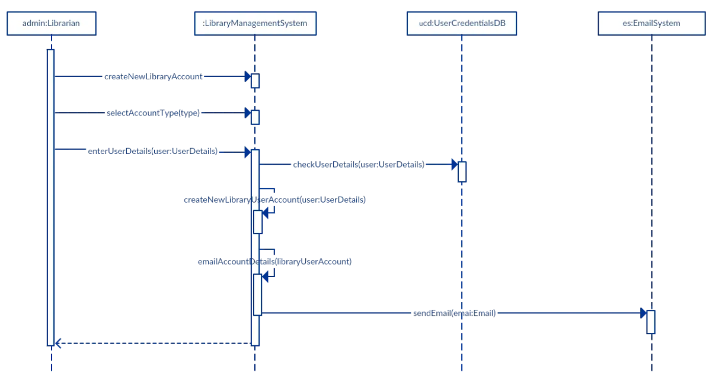
Steps to create new library User Account
From each of these steps, you can easily specify what messages should be exchanged between the objects in the sequence diagram.
The librarian request the system to create a new online library account
The librarian then selects the library user account type
The librarian enters the user’s details
The user’s details are checked using the user Credentials Database
The new library user account is created
A summary of the of the new account’s details are then emailed to the user

Slide 26
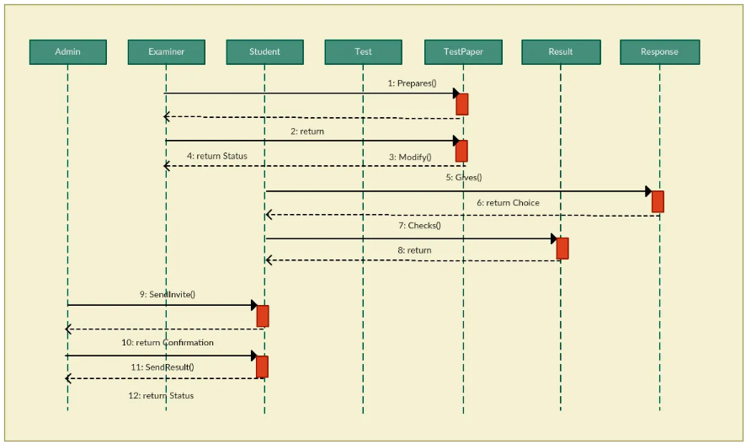
Notes:
Sequence Diagram of online exam system

Slide 27
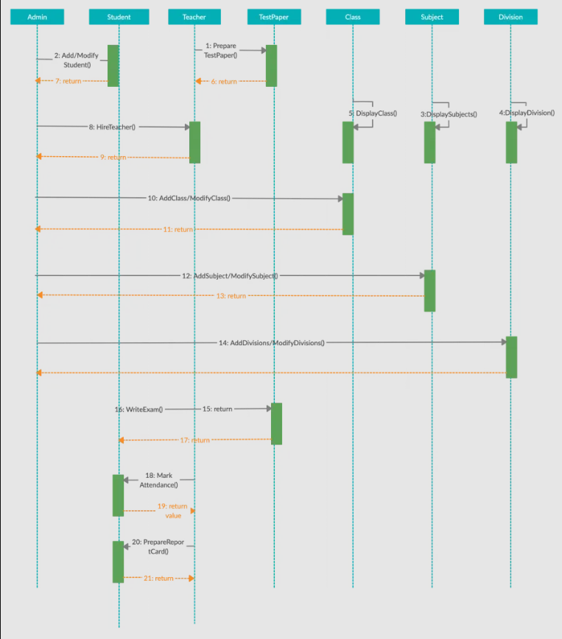
Notes:
Sequence Diagram Example of a School Management System

Slide 28
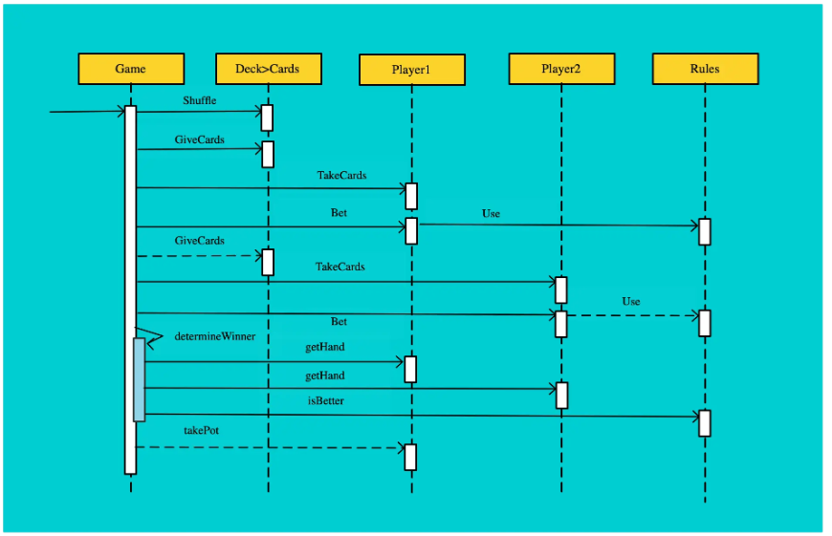
Notes:
Sequence Diagram Example of a Card Game

Slide 29
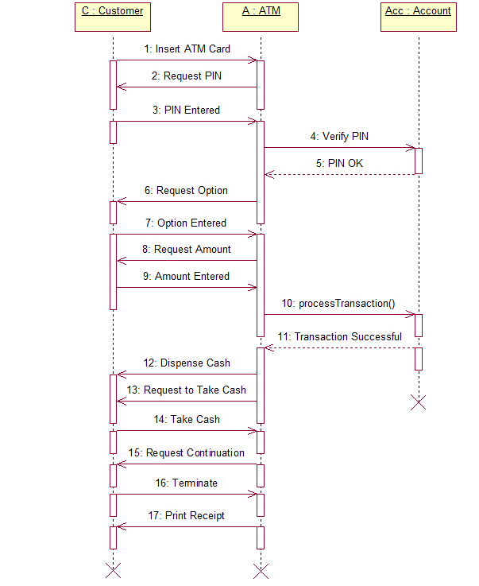
Notes:
Sequence Diagram for an ATM cash Withdrawal

Slide 30
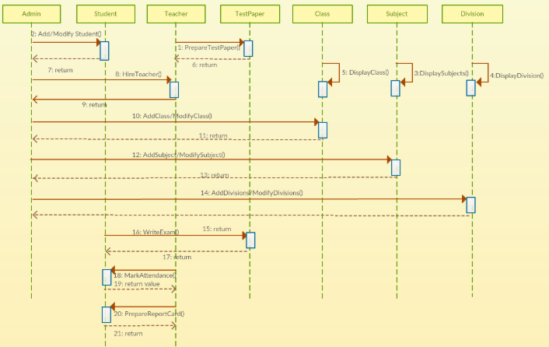

Slide 31
Reference
https://creately.com/guides/sequence-diagram-tutorial/

